Slide 1
3D MIMO-SAR IMAGING
ALGORITHMS &
EXAMPLE DATA SET
MUHAMMET EMIN YANIK
ADVISOR: PROF. MURAT TORLAK
The University of Texas at Dallas
September, 2019
1

Slide 2
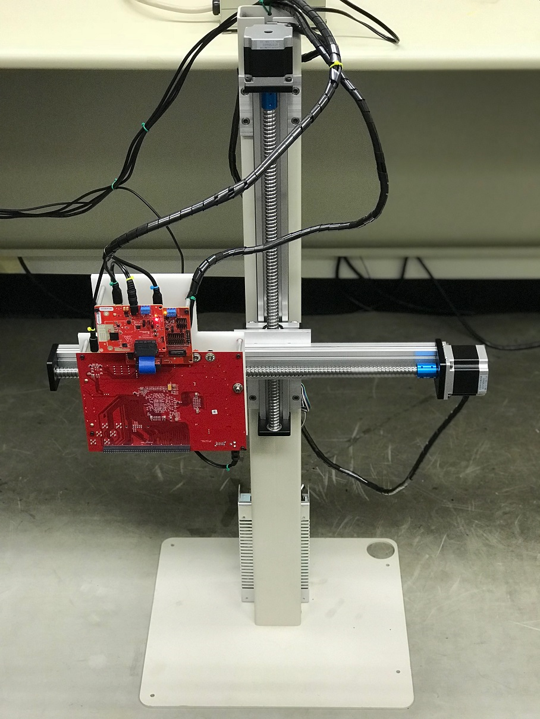
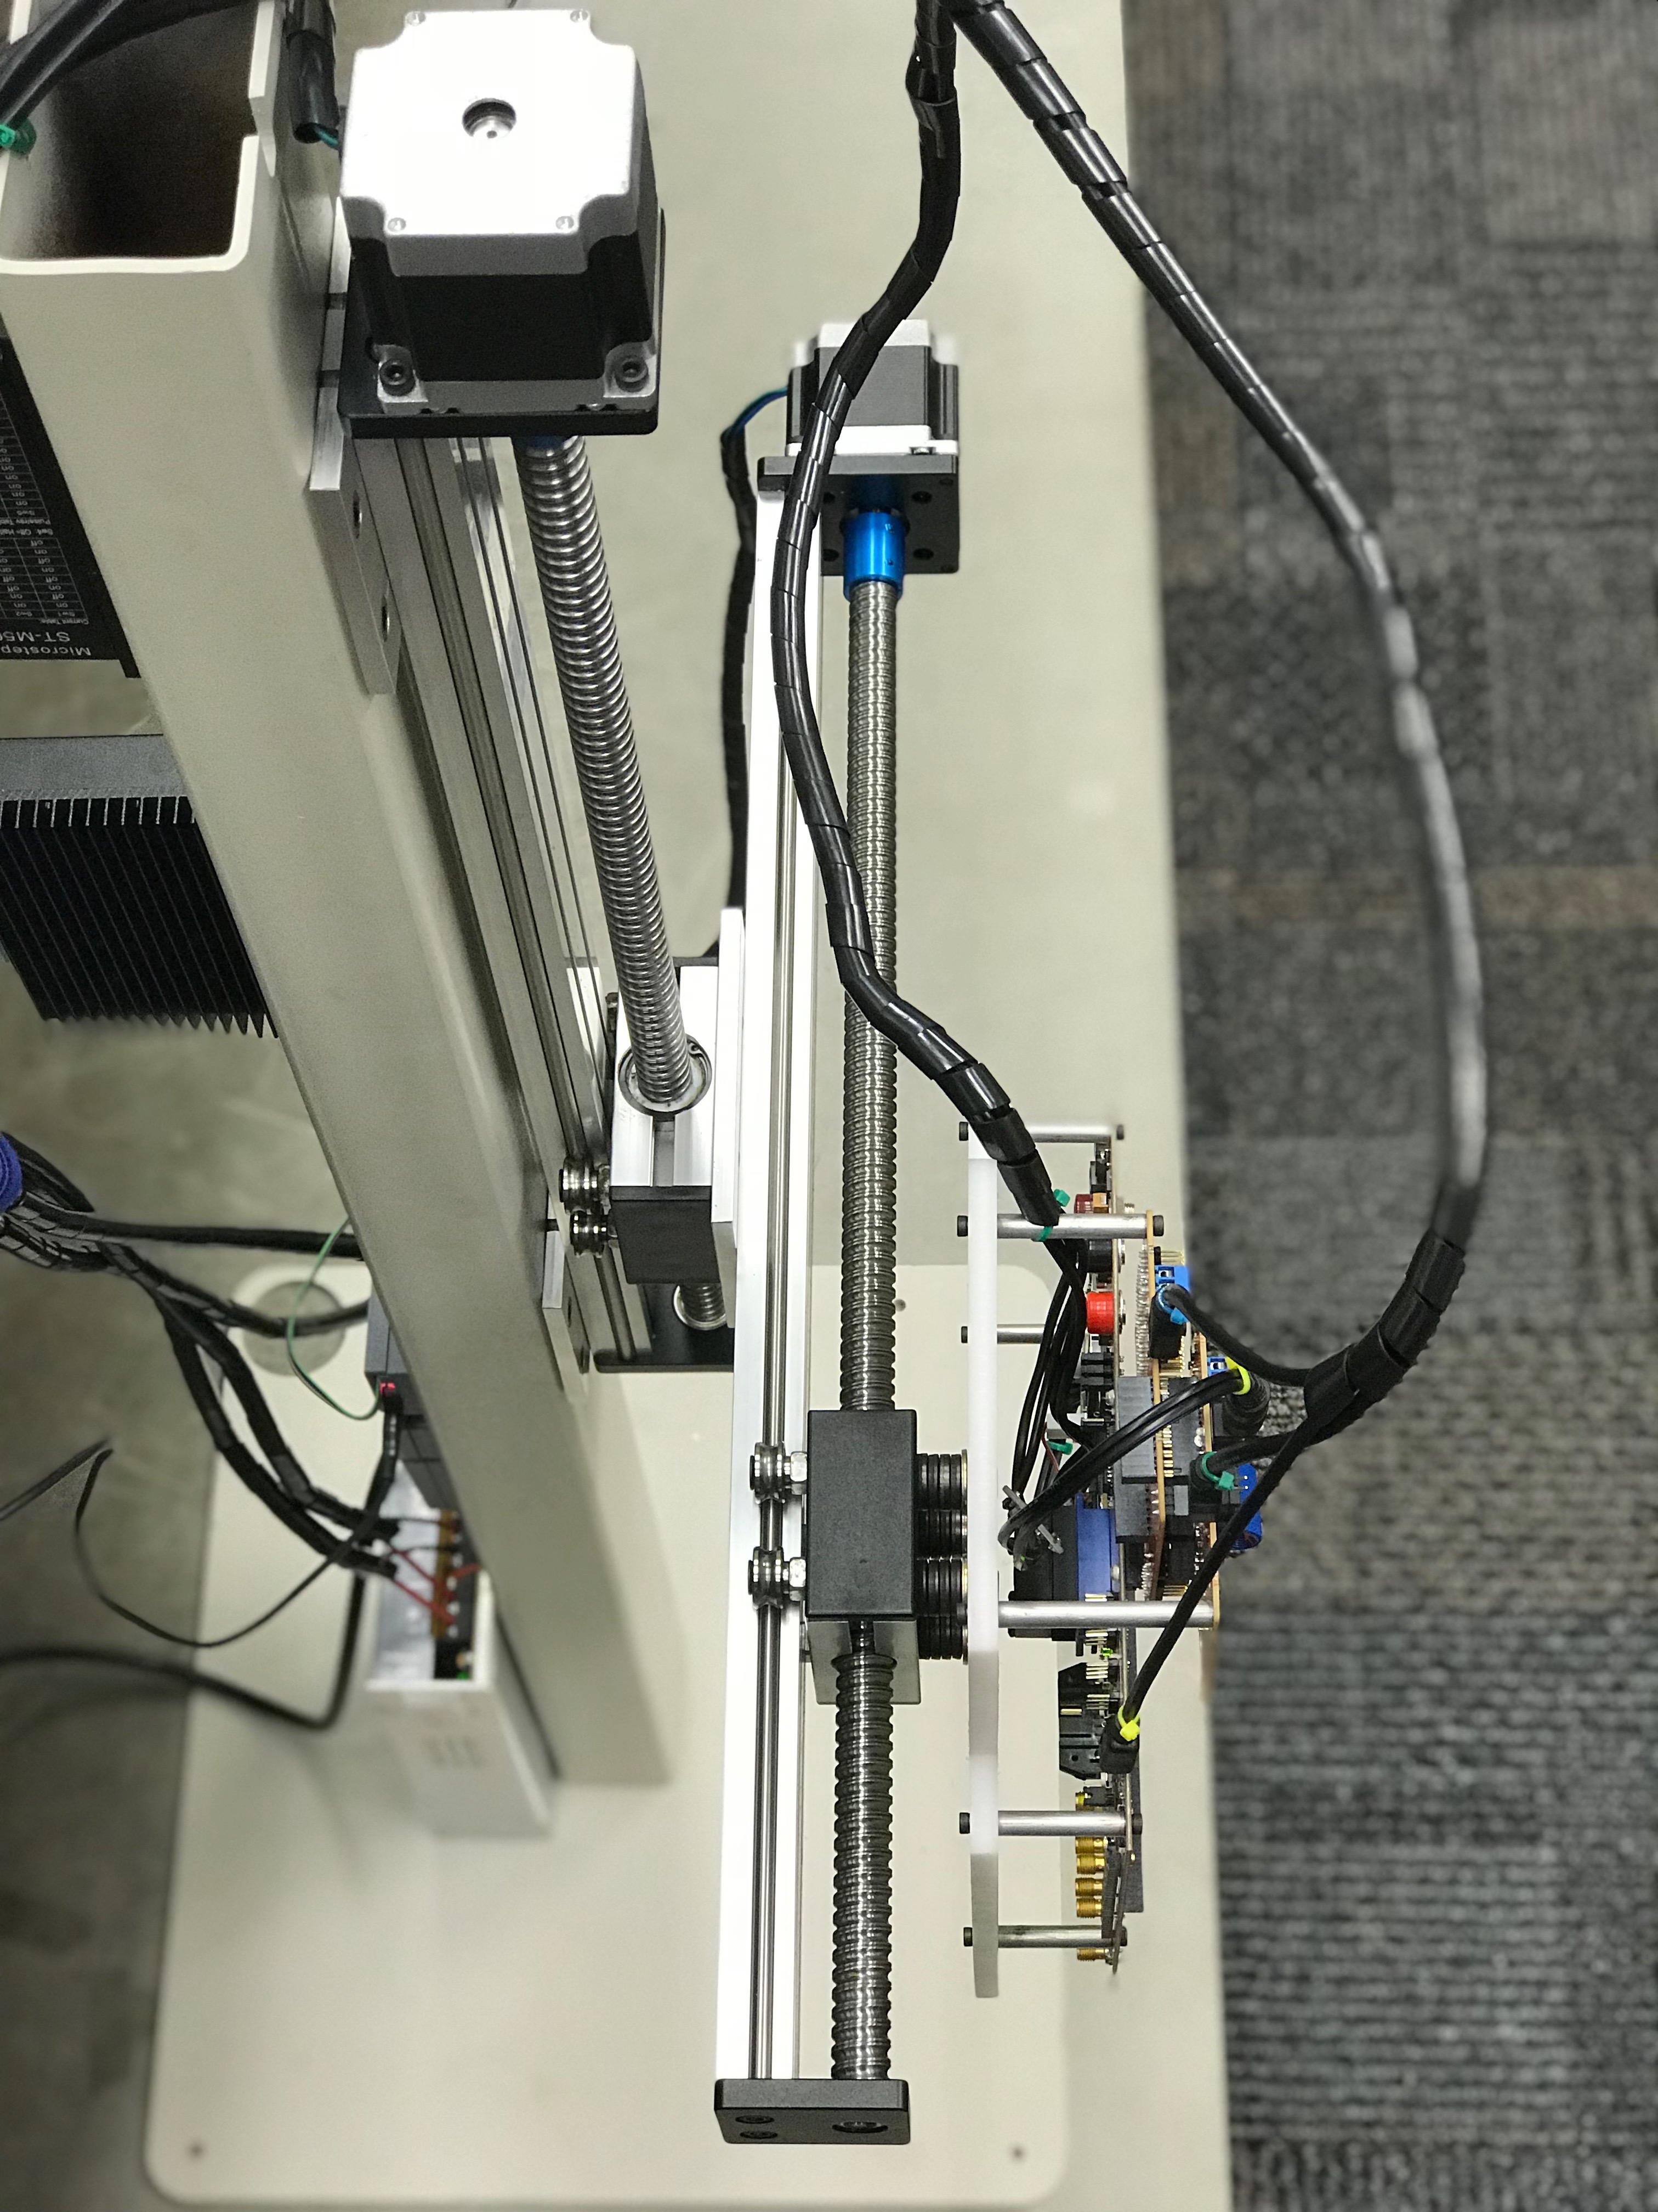
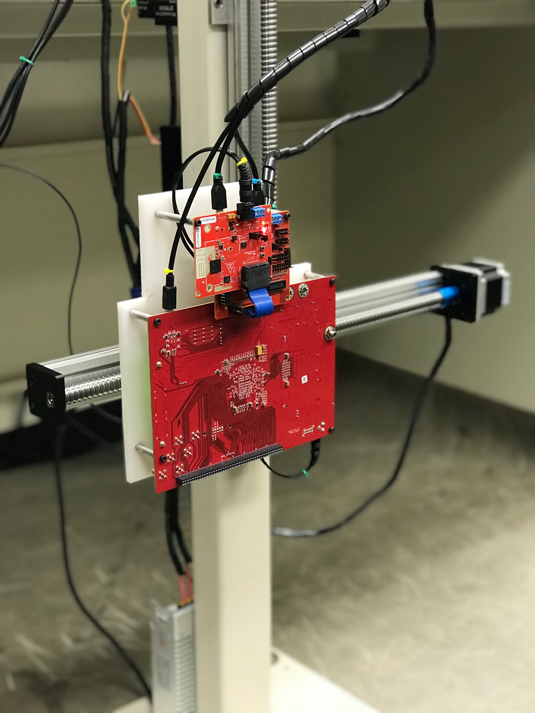
New mmwave imager TESTBED
A new version of the 2-axis mechanical scanner is built using metal parts and stand.
The maximum scanning range is 400 mm by 400 mm
Maximum speed is 20 mm/s
The mmWave sensor hardware:
77 GHz IWR1443-Boost
mmWave-Devpack+TSW1400
3

Slide 3
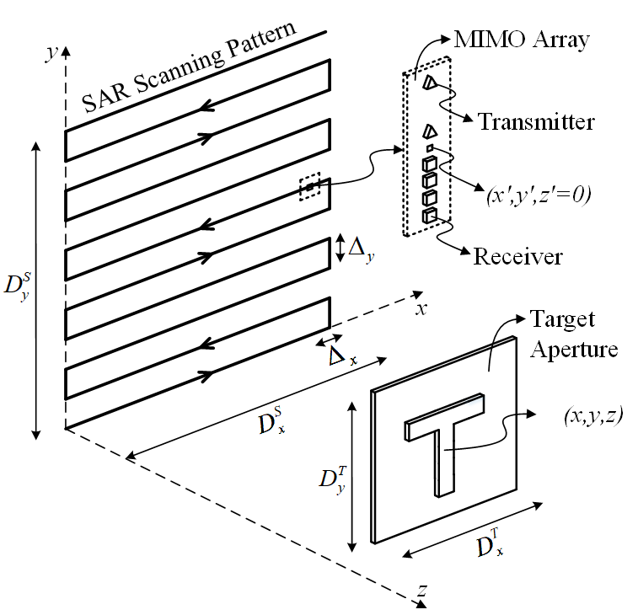
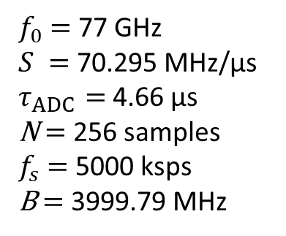
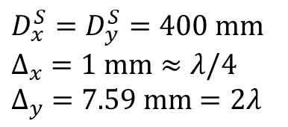
MIMO-SAR SYSTEM CONFIGURATION
Data collection is performed by moving a single-chip MIMO radar along a trajectory in $x−y$ plane
MIMO array topology of IWR1443-Boost (2 TX, 4 RX )
SAR parameters:
$$D_{x}^{S}=D_{y}^{S}=400 mm$$
$$∆_{x} =1 mm≈λ/4$$
$$∆_{y} =7.59 mm=2λ$$
Chirp parameters:
$f_{0}$ $=$ 77 GHz
$S =$ 70.295 MHz/µs
$τ_{ADC}=$ 4.66 µs
N $=$ 256 samples
$f_{s}$ $=$ 5000 ksps
B $=$ 3999.79 MHz

Slide 4
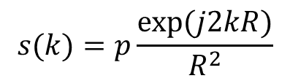
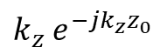
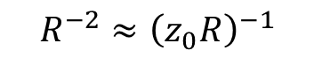
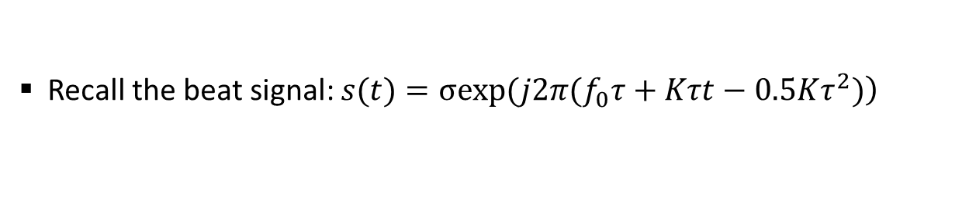
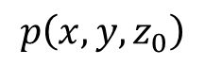
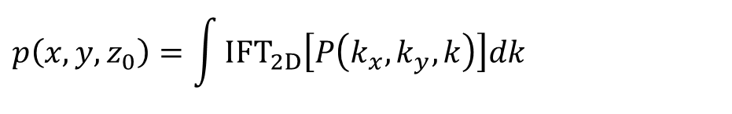
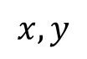
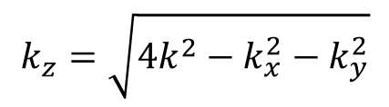
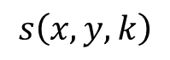
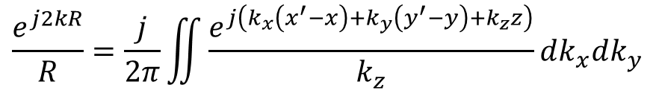
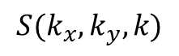
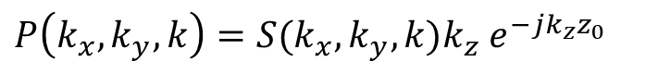
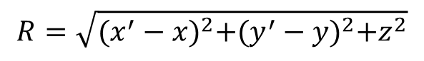
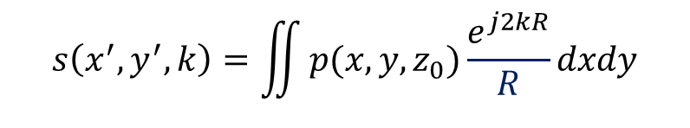
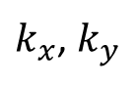
3-d MONOSTATIC Image reconstruction
Recall the beat signal: $\left.s(t)=σexp(j2π(f_{0}τ+Kτt−0.5Kτ^{2})\right)$
Residual video phase (RVP) is negligible
Rewrite in the wavenumber domain as:
$$s\left(x,y,k\right)$$
$$s(k)=p\frac{exp⁡(j2kR)}{R^{2}}$$
$$R=\sqrt{{(x^{′}−x)}^{2}+{(y^{′}−y)}^{2}+z^{2}}$$
$$x,y$$
FFT2
$$S(k_{x},k_{y},k)$$
The received monostatic backscattered data from a 3-D target slice (at $z_{0}$)
$$s\left(x^{′},y^{′},k\right)=\iint{p(x,y,z_{0})\frac{e^{j2kR}}{R}dxdy}$$
Phase Correction
$$R^{−2}≈{\left(z_{0}R\right)}^{−1}$$
$k_{z}$ $e^{−jk_{z}z_{0}}$
Representation of a spherical wave as a superposition of plane waves
$k_{x}$, $k_{y}$
IFFT2
$$\frac{e^{j2kR}}{R}=\frac{j}{2π}\iint{\frac{e^{j\left(k_{x}\left(x^{′}−x\right)+k_{y}\left(y^{′}−y\right)+k_{z}z\right)}}{k_{z}}dk_{x}dk_{y}}$$
$$k_{z}=\sqrt{4k^{2}−k_{x}^{2}−k_{y}^{2}}$$
Integrate over k
Image slice in spectral domain:
$P\left(k_{x},k_{y},k\right)=S(k_{x},k_{y},k)k_{z}$ $e^{−jk_{z}z_{0}}$
$$p\left(x,y,z_{0}\right)=\int{{IFT}_{2D}\left[P\left(k_{x},k_{y},k\right)\right]dk}$$
$$p\left(x,y,z_{0}\right)$$
The final image slice:
3-D image slice formation
4

Slide 5
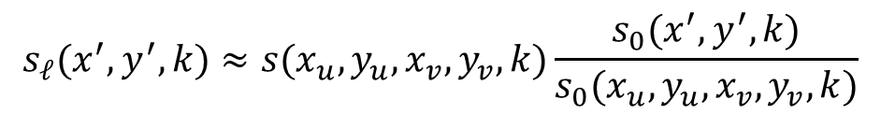
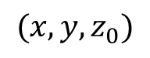
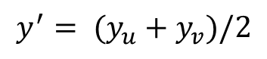
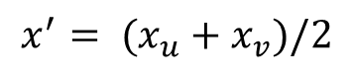
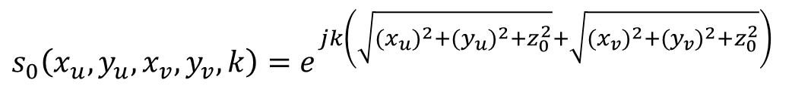
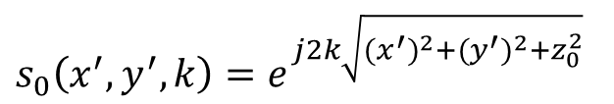
MULTISTATIC EFFECT IN NEAR-FIELD
Midpoint approximation: $\left|r_{u}−r_{v}\right|≤\sqrt{4αλR}$ for a small $α$ doesn’t hold in near field
The total round-trip distance for the $ℓ$-th virtual channel
$$R_{u}+R_{v}=\sqrt{{(x_{u}−x)}^{2}+{(y_{u}−y)}^{2}+z_{0}^{2}}+\sqrt{{(x_{v}−x)}^{2}+{(y_{v}−y)}^{2}+z_{0}^{2}}$$
Multistatic to monostatic phase correction is used
$$s_{ℓ}(x^{′},y^{′},k)≈s(x_{u},y_{u},x_{v},y_{v},k)\frac{s_{0}(x^{′},y^{′},k)}{s_{0}(x_{u},y_{u},x_{v},y_{v},k)}$$
Where:
$$x^{′}= (x_{u}+x_{v})/2$$
$$y^{′}= (y_{u}+y_{v})/2$$
$$s_{0}\left(x_{u},y_{u},x_{v},y_{v},k\right)=e^{jk\left(\sqrt{{(x_{u})}^{2}+{(y_{u})}^{2}+z_{0}^{2}}+\sqrt{{(x_{v})}^{2}+{(y_{v})}^{2}+z_{0}^{2}}\right)}$$
$$(x,y,z_{0})$$
$$s_{0}\left(x^{′},y^{′},k\right)=e^{j2k\sqrt{{(x^{′})}^{2}+{(y^{′})}^{2}+z_{0}^{2}}}$$
5

